Slide 1

Data-Driven Fare and Duration prediction with Peak hour classification for NYC Taxi Trips
Group D
Team Members:
Tejaswini Penneni
Shiva Shankar Kanike
Soniya Koduru

Slide 2
Introduction
Our project aims to develop a predictive model to estimate taxi fares and trip durations for NYC taxi rides and classify trips into peak and off-peak hours. The system will utilize machine learning models to offer real-time predictions, integrated with an interactive web interface using Streamlit for user input and outputs.
This project was chosen to provide a web interface for passengers to input their trip details and instantly get predictions, improving convenience. And it helps to plan their trips more effectively by avoiding surprises related to fare or travel time.

Slide 3
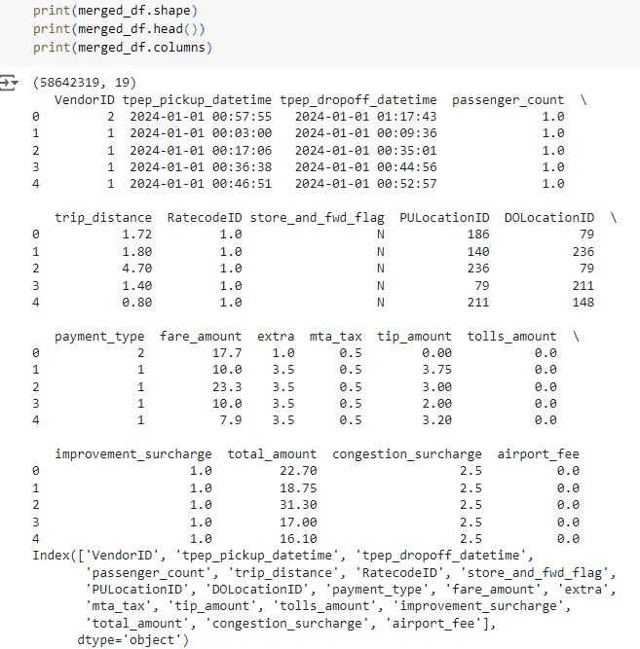
Dataset
Source: NYC Taxi and Limousine Commission (TLC)
Link: https://www.nyc.gov/site/tlc/about/tlc-trip-record-data.page
This dataset contains 19 columns and 58,642,319 rows, covering taxi rides from January 2023 to June 2024.

Slide 4
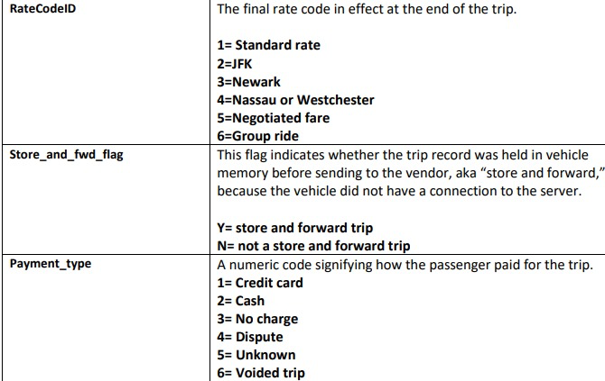
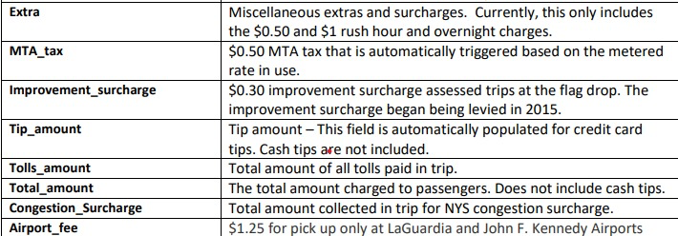
Dataset Contd…

Slide 5
Machine Learning Tasks
Prediction: Fare and trip duration
Classification: Peak vs. Off-peak hours
Platform: Web-based (Streamlit integration)

Slide 6
Literature Review
Study 1: NYC Taxi Trip Duration Prediction Using MLP and XGBoost
This study aimed to predict the duration of taxi rides using ML models XGBoost and Multi-Layer Perceptron (MLP). They predict rides duration based on data such as pickup/drop-off times, trip distance, start time, and the number of passengers. found that XGBoost provided better accuracy in predicting trip duration. The research emphasized the need for accurate trip time predictions to help users plan their journeys effectively and avoid surge pricing.[2]
Study 2: Predicting NYC Taxi Trip Duration Using ML and Time Series Forecasting
Analyzed how various factors like time of day, day of the week, and trip locations impact taxi trip durations. This study tested both machine learning and deep learning models, specifically XGBRegressor and Recurrent Neural Networks (RNN), for time series forecasting. The results showed that RNN slightly outperformed XGBRegressor.[3]

Slide 7
How is your Approach different?
Unlike both studies, which focus mainly on trip duration, our project also predicts taxi fares. This adds a useful feature for passengers.
We introduce a new classification feature: determining whether a trip happens during peak or off-peak hours. This isn’t covered in the previous studies, and it can help users plan their trips better.
Our project will provide a user-friendly platform using Streamlit where users can input details like pickup/drop-off location and time, and immediately get predictions for both fare and trip duration. This interactive experience sets our project apart by allowing real-time use.
By combining both regression for fare and duration prediction and classification for peak hours, our project delivers a more complete and user-focused solution than existing studies.

Slide 8
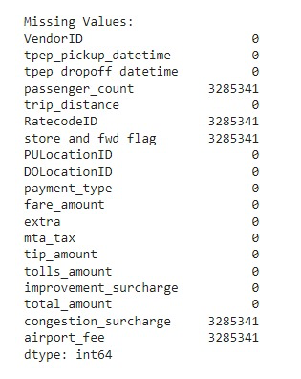
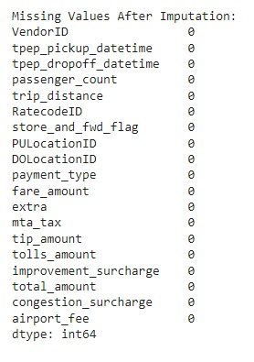
Data Cleaning
We have found 5% of missing values in respective fields, and we replaced passenger_count, RateCodeId and
Store_and_fwd_flag missing values with mode. And congestion_surcharge and airport_fee Replaced with 0.

Slide 9
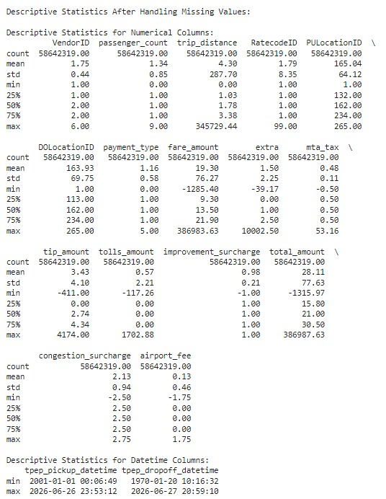
Data Cleaning ctnd..

Slide 10
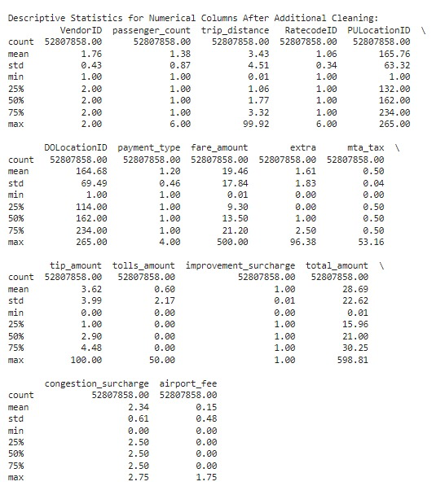
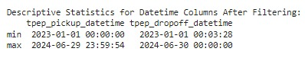
Data Cleaning Ctnd…

Slide 11
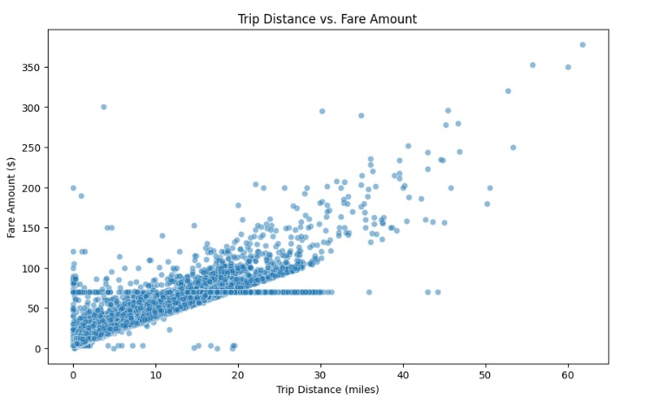
Exploratory Data Analysis

Slide 12
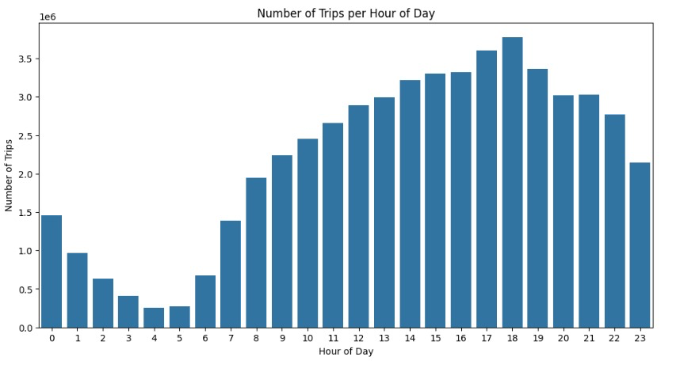
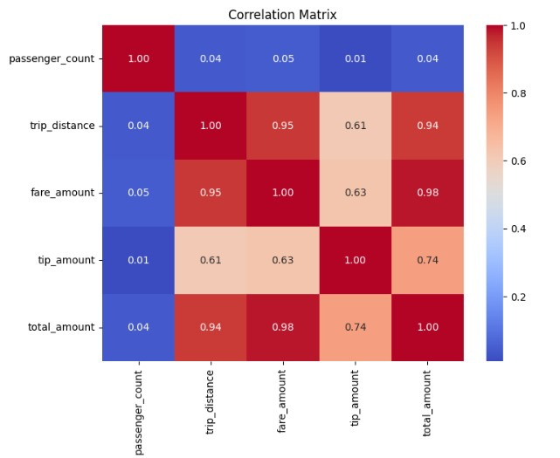
EDA Ctnd…

Slide 13
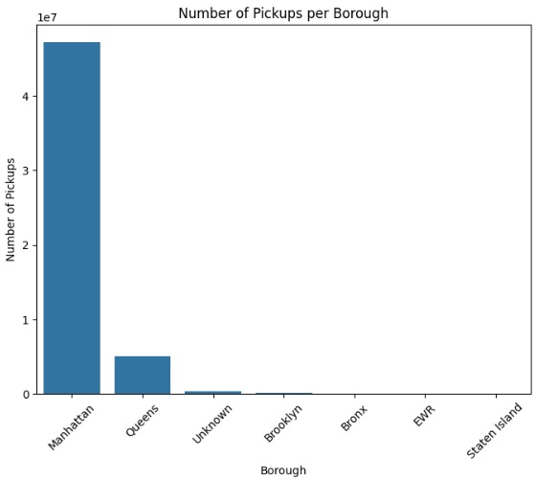
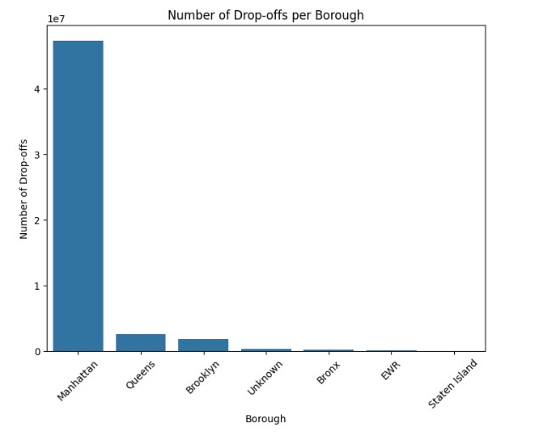
EDA Ctnd…

Slide 14
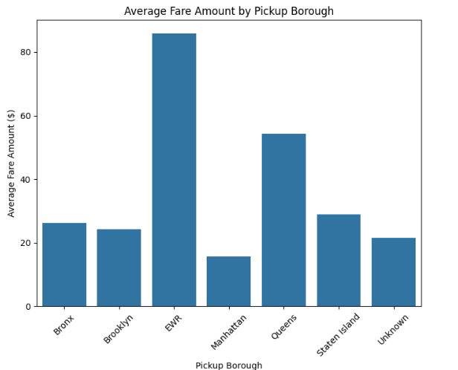
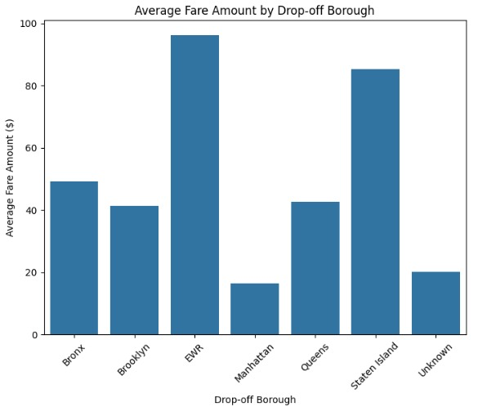
EDA Ctnd…

Slide 15
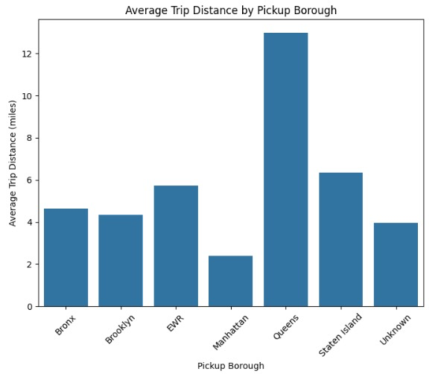
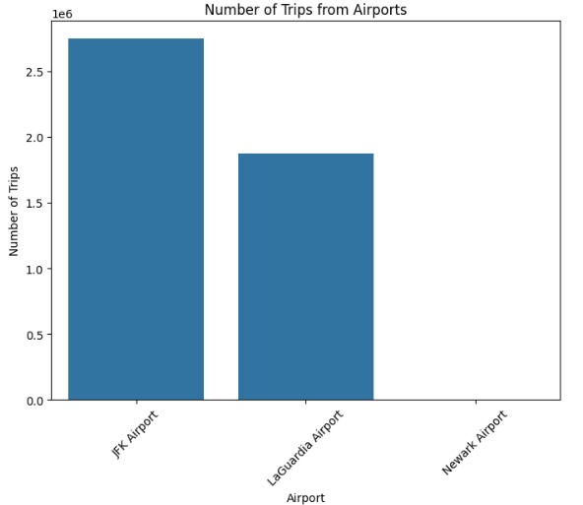
EDA Ctnd…

Slide 16
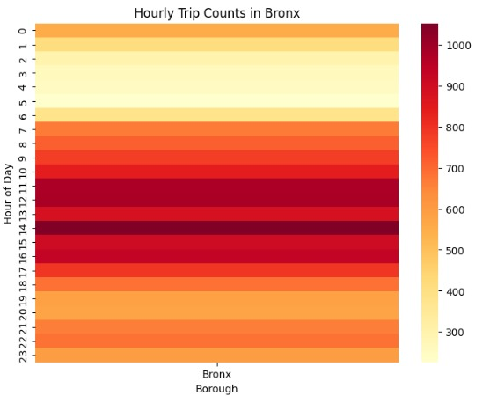
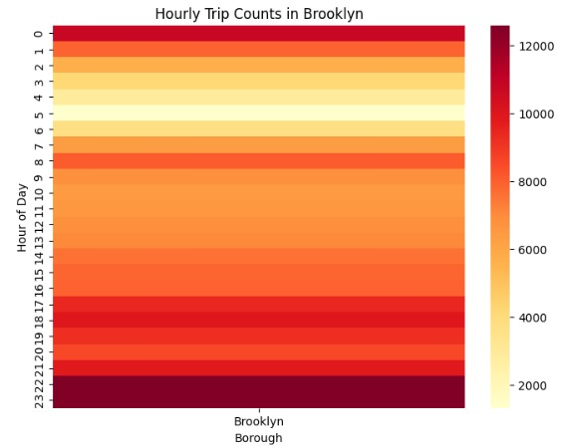
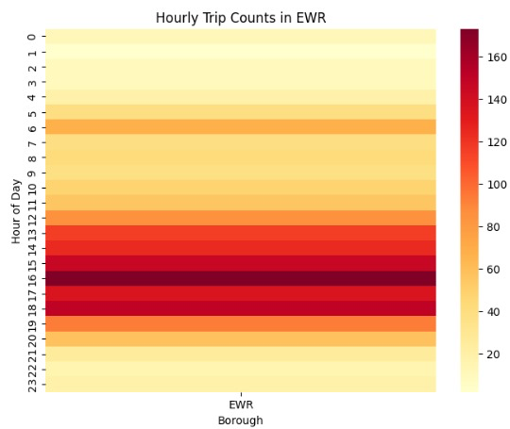
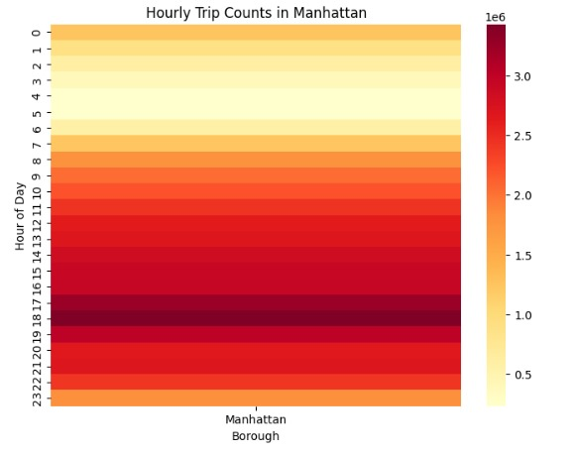
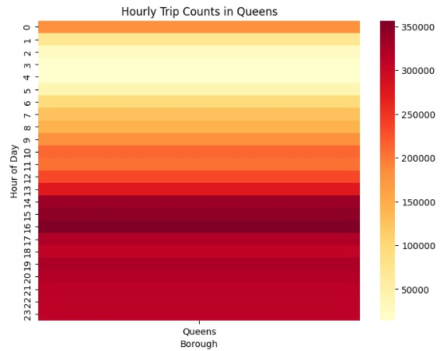
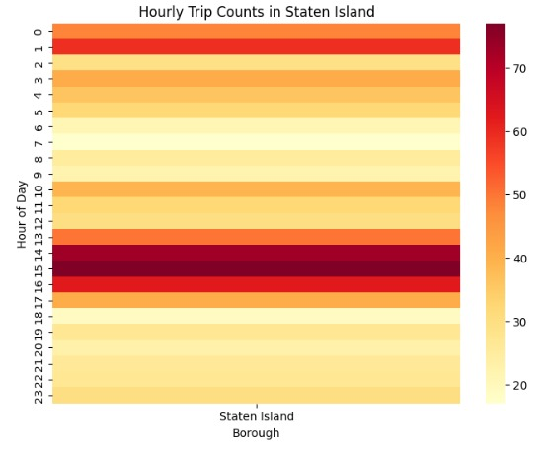
Heat Maps for Hourly Trip counts from top 5 pickup Boroughs

Slide 17
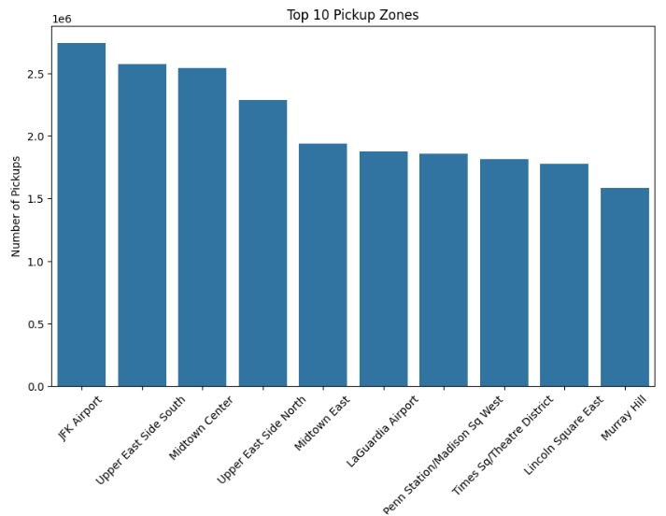
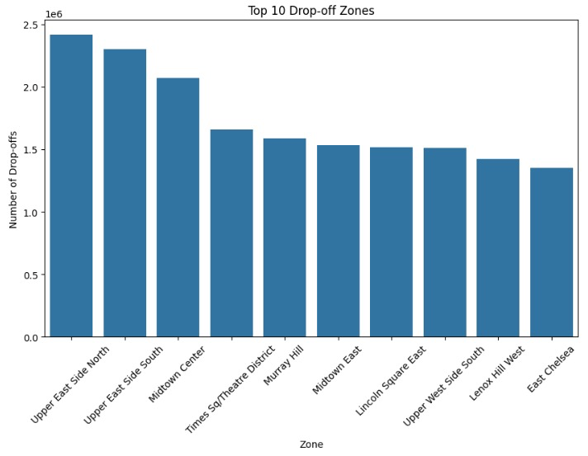
These graphs shows that top pickup and drop off zones in NYC,
where we can observe that most of the pickups from JFK Airport and
drop-offs from Upper east Side North

Slide 18
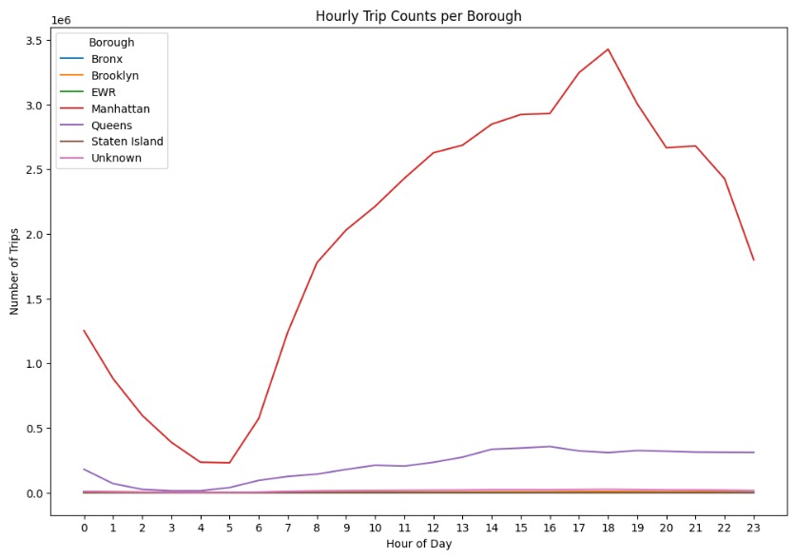
This graph shows Hourly Trip Counts per Borough, illustrating the number of trips throughout the day for different boroughs in New York City.

Slide 19
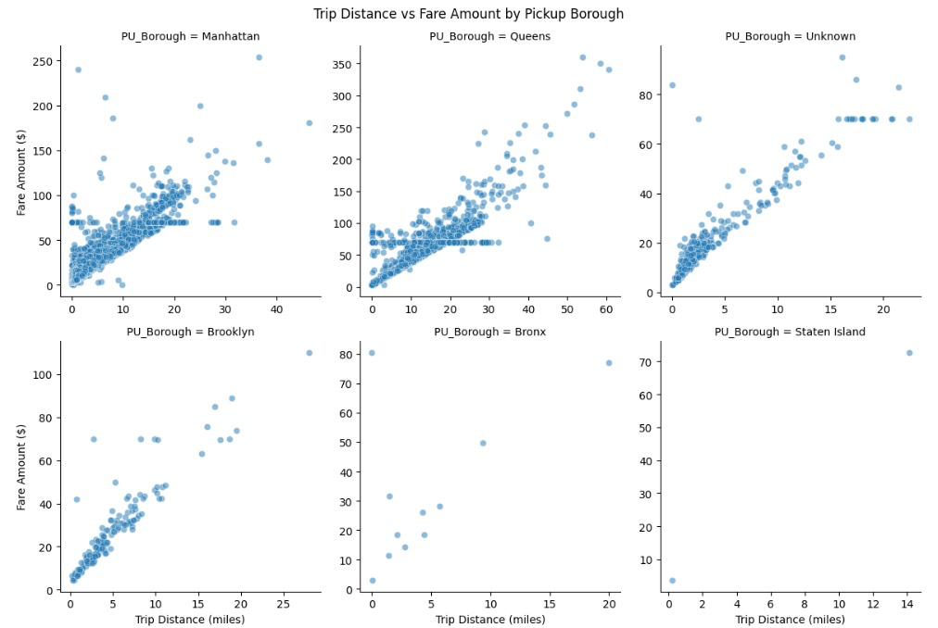
Scatter Plots for trip distance trip distance (in miles) and fare amount (in dollars) for taxi rides across different boroughs in New York City

Slide 20
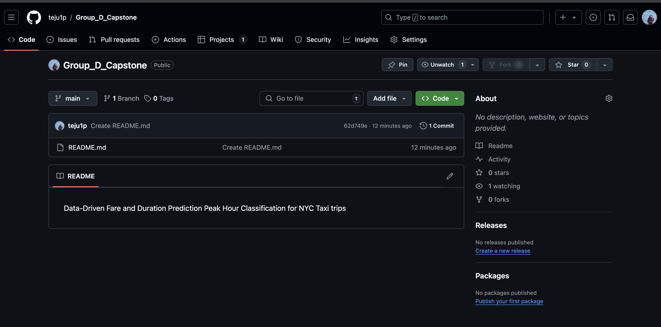
GitHub Account
Git Account: https://github.com/teju1p/Group_D_Capstone

Slide 21
Next Steps
Planned Methods:
Feature Engineering
Applying Regression for fare and time duration prediction
Classifying peak hours
Building the web interface using Streamlit for user inputs and real-time predictions.

Slide 22
Conclusion
We have made significant progress by cleaning our dataset and performing exploratory data analysis. Our next steps will focus on feature engineering, model development, and creating a user-friendly web interface to deliver accurate fare and duration predictions, along with peak hour classifications.

Slide 23
References
https://www.nyc.gov/site/tlc/about/tlc-trip-record-data.page
Poongodi, M., Malviya, M., Kumar, C. et al. New York City taxi trip duration prediction using MLP and XGBoost. Int J Syst Assur Eng Manag 13 (Suppl 1), 16–27 (2022). https://doi.org/10.1007/s13198-021-01130-x
Ramani, S., Ghiya, A., Aravind, P.S., Karuppiah, M., Pelusi, D. (2022). Predicting New York Taxi Trip Duration Based on Regression Analysis Using ML and Time Series Forecasting Using DL. In: Raj, J.S., Shi, Y., Pelusi, D., Balas, V.E. (eds) Intelligent Sustainable Systems. Lecture Notes in Networks and Systems, vol 458. Springer, Singapore. https://doi.org/10.1007/978-981-19-2894-9_2

Slide 24
THANK YOU

